Slide 1
User loan default Prediction
Zhenhao Zhang
Thomas Xiong

Slide 2



Project Choice and Rationale
Notes:
In the current economic climate, financial institutions are increasingly focusing on minimizing risks associated with lending. One of the critical risks is the potential for loan defaults, which can significantly impact the financial stability of these institutions. Therefore, accurately predicting customer loan default has become essential for banks and other lenders to make informed decisions on loan approvals and risk management. The rationale behind choosing this project is to leverage data mining techniques to improve the accuracy of default predictions, thereby reducing financial risks and enhancing decisionmaking processes.

Slide 3
The Goal
The project aims to develop a predictive model to accurately forecast loan defaults, enhancing financial decision-making and risk management.

Slide 4
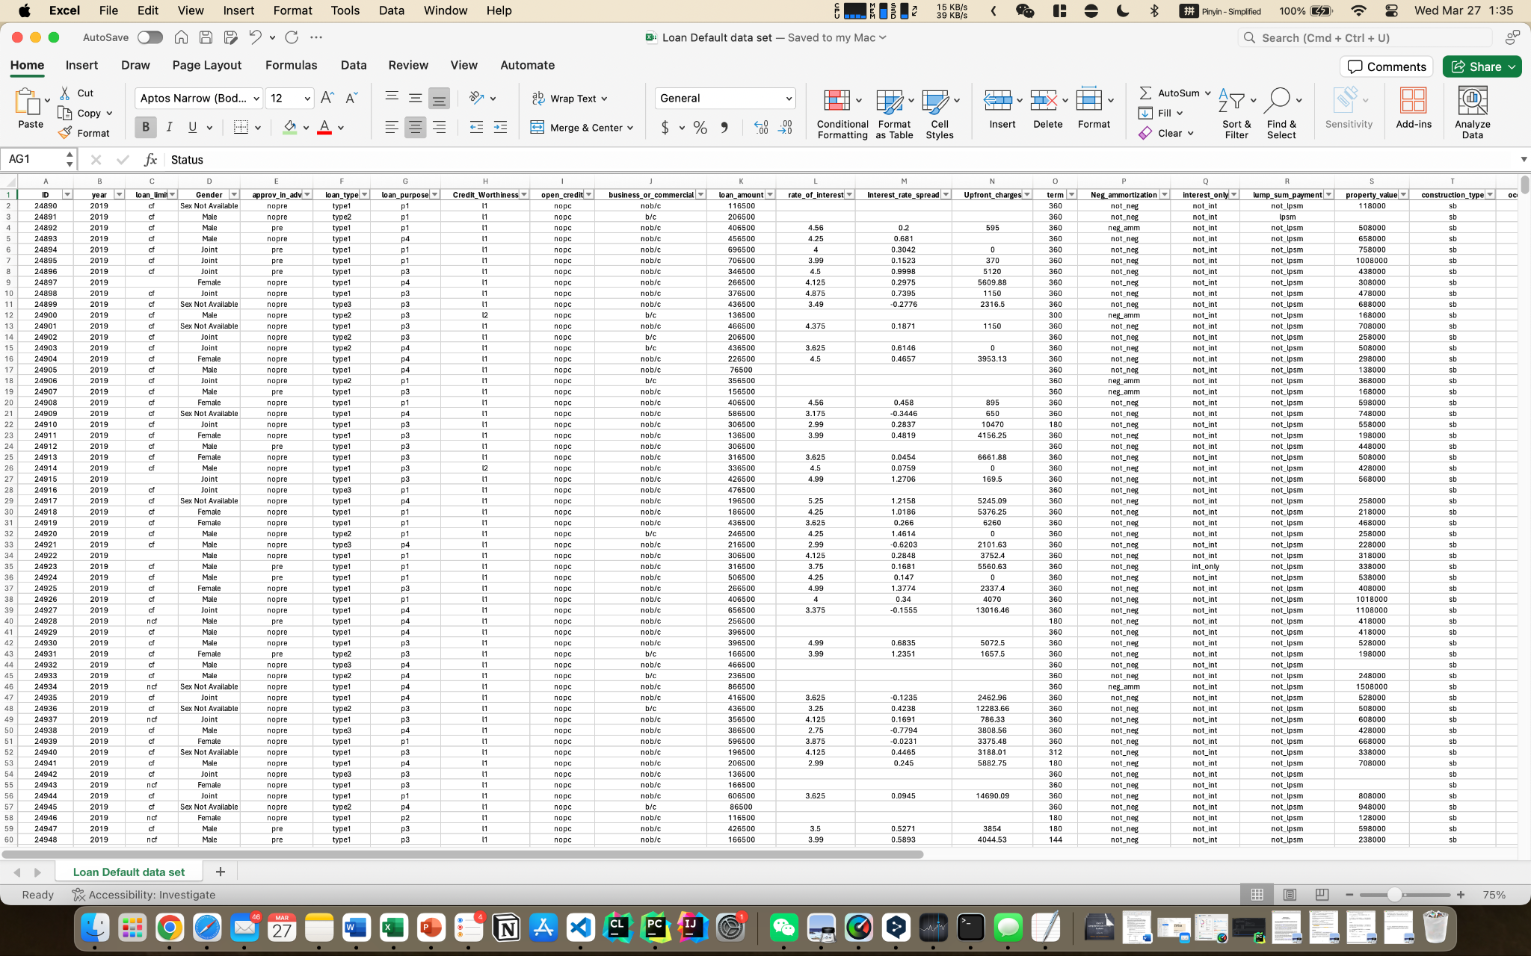
Step 1: Understanding the data
Notes:
This dataset includes 148,670 entries and 34 variables, encompassing a wide range of information related to loan applications. It covers personal details, loan characteristics, property specifics, financial indicators, and loan outcomes, aimed at analyzing factors influencing loan default risks.

Slide 5
Loan Information
- loan_limit: Loan Limit - loan_type: Loan Type
- loan_purpose: Loan Purpose - loan_amount: Loan Amount
- rate_of_interest: Interest Rate - Interest_rate_spread: Interest Rate Sprea
- Upfront_charges: Upfront Charges - term: Loan Term
- interest_only: Interest Only - lump_sum_payment: Lump Sum Payment
- Neg_ammortization: Negative Amortization

Slide 6
Housing
- property_value: Property Value
- construction_type: Construction Type
- occupancy_type: Occupancy Type
- Secured_by: Secured By
- total_units: Total Units

Slide 7
Applicant Information
- Gender: Gender - approv_in_adv: Approval in Advance
- Credit_Worthiness: Credit Worthiness - open_credit: Open Credit
- business_or_commercial: Business or Commercial - credit_type: Credit Type
- Credit_Score: Credit Scor - age: Age
- co-applicant_credit_type: Co-applicant Credit Type - income: Income
- submission_of_application: Submission of Application - Region: Region
- LTV: Loan to Value Ratio
- Status: Status 1 for default, 0 for non-default
- dtir1: Debt-to-Income Ratio 1
Notes:
其中“Status”可能表示贷款是否违约（1表示违约，0表示未违约）

Slide 8
Other informations
- ID
- Year
- Security_Type

Slide 9
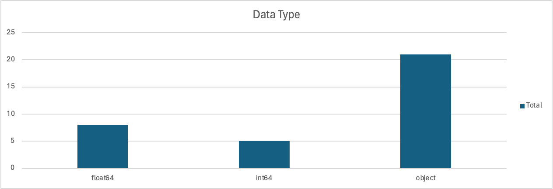

Slide 10
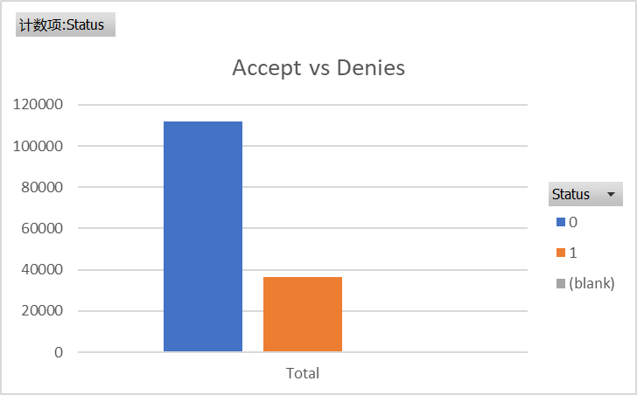

Slide 11
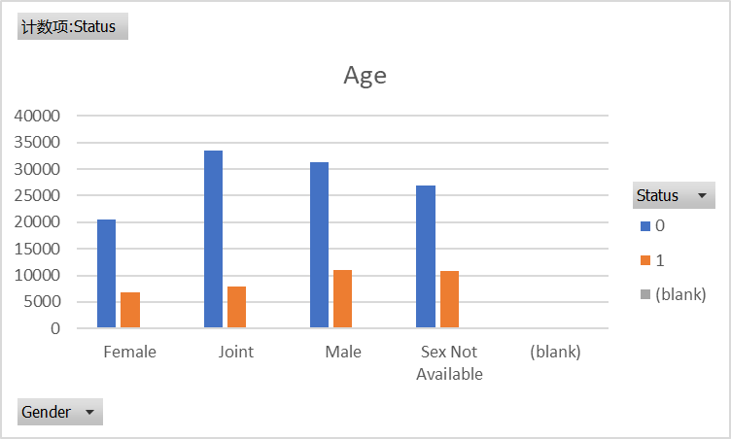

Slide 12
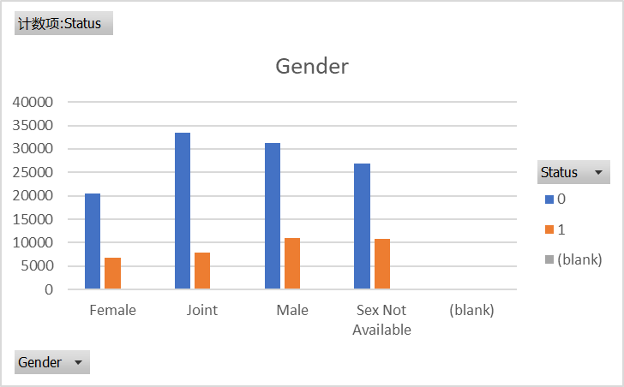

Slide 13
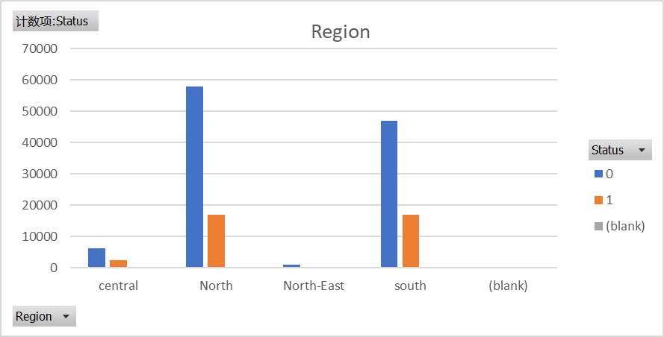

Slide 14
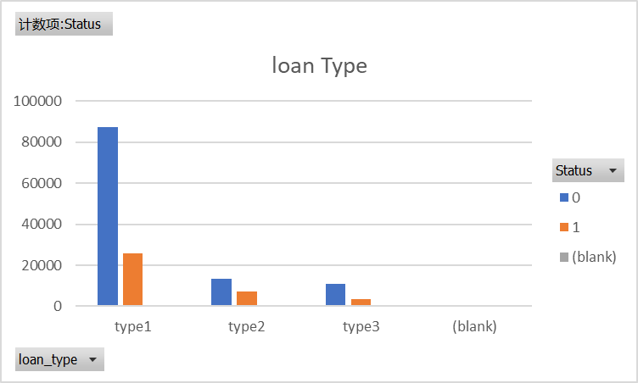

Slide 15
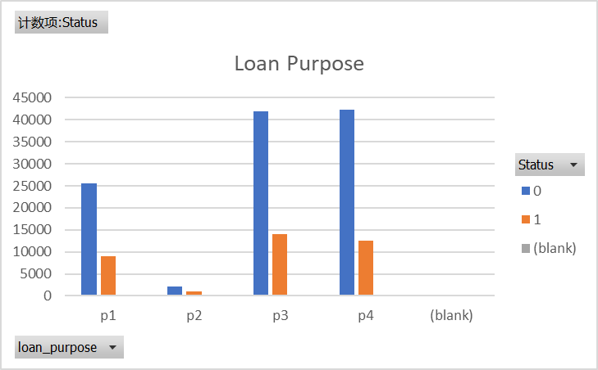

Slide 16
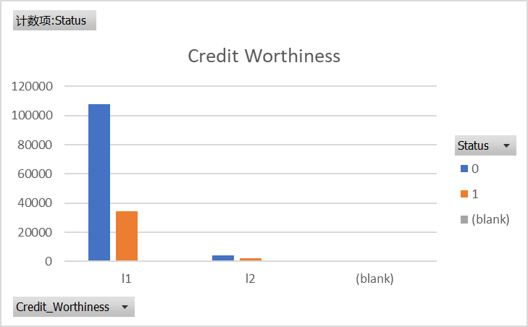

Slide 17
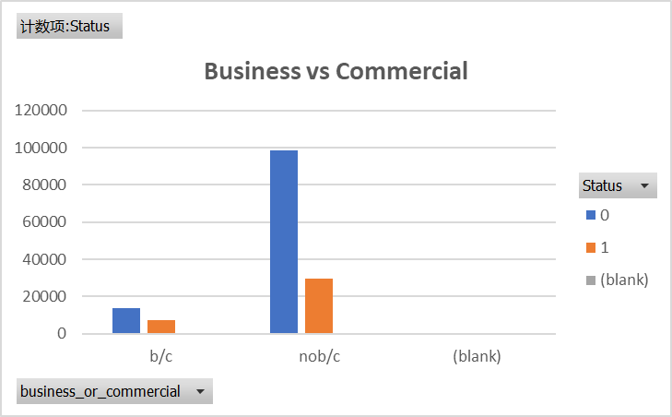

Slide 18
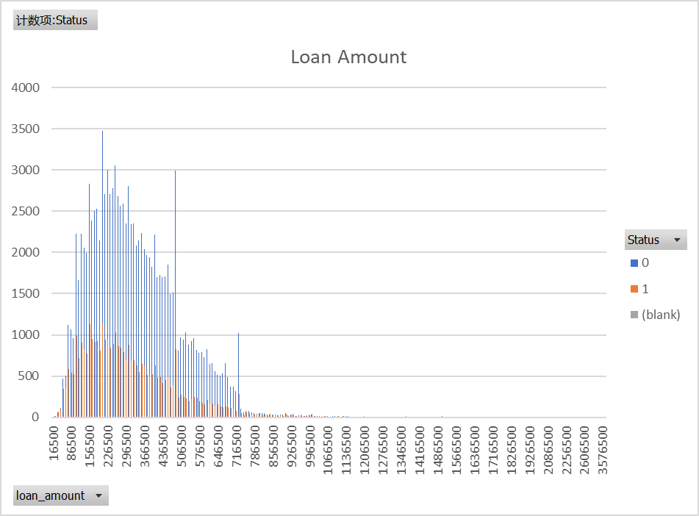

Slide 19
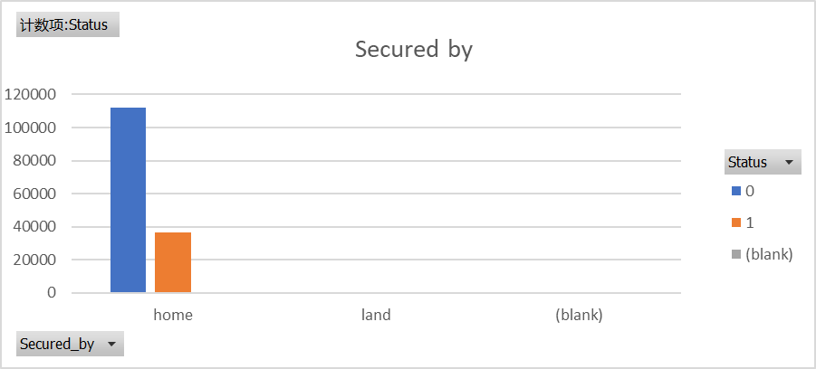

Slide 20
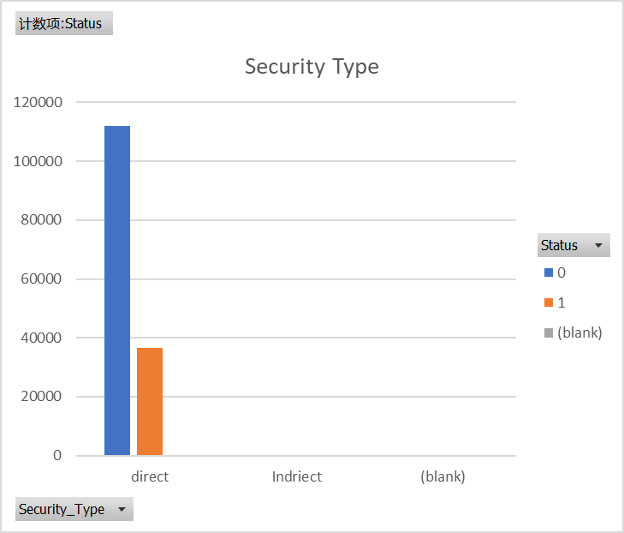

Slide 21
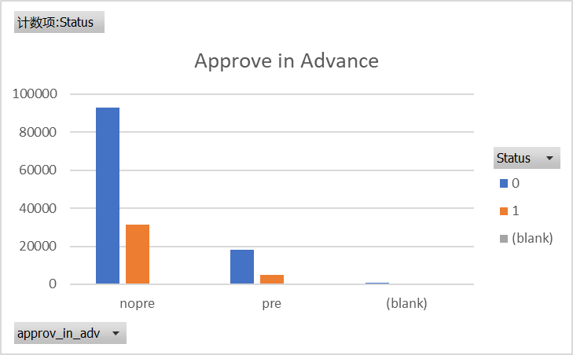

Slide 22
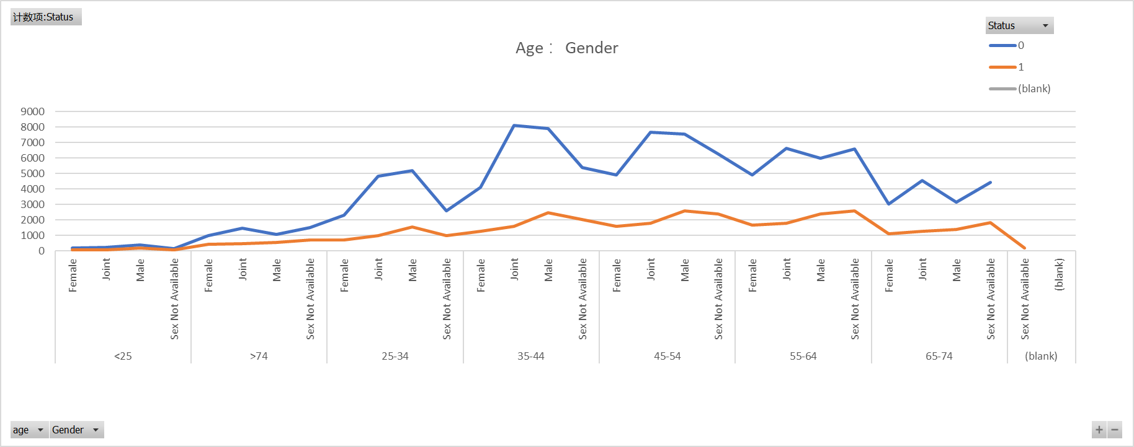

Slide 23
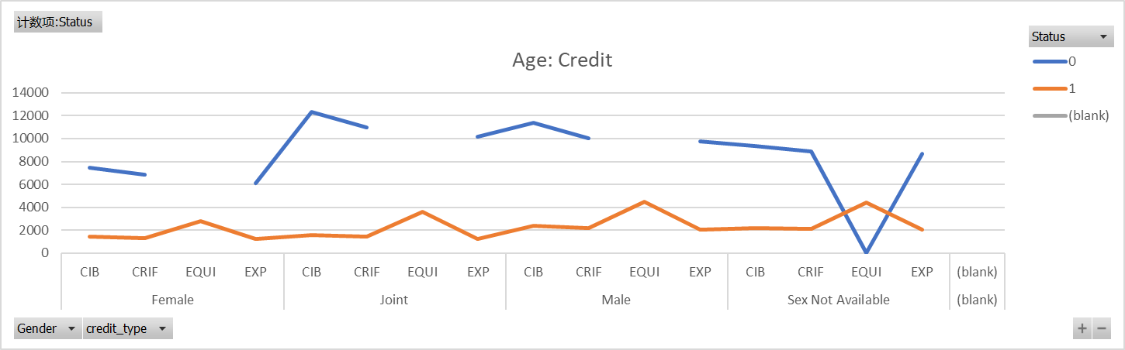

Slide 24
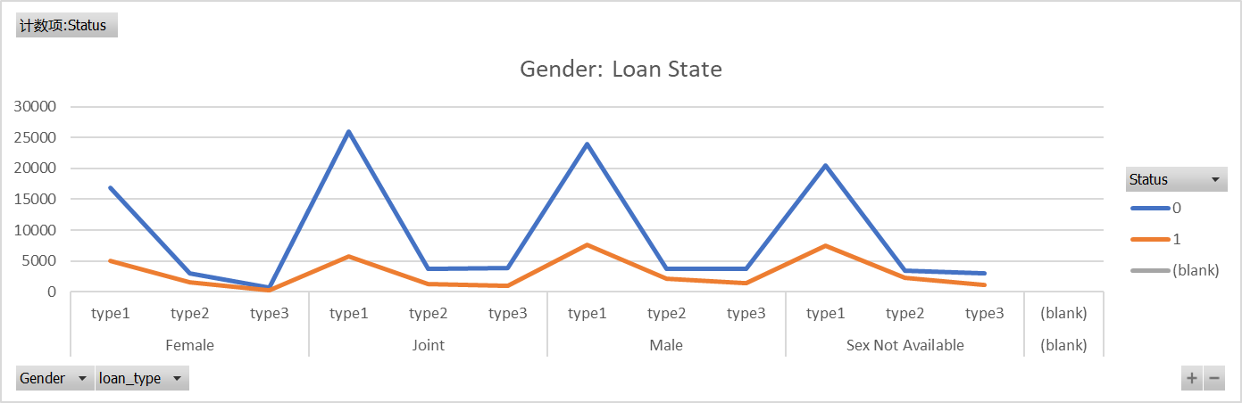

Slide 25
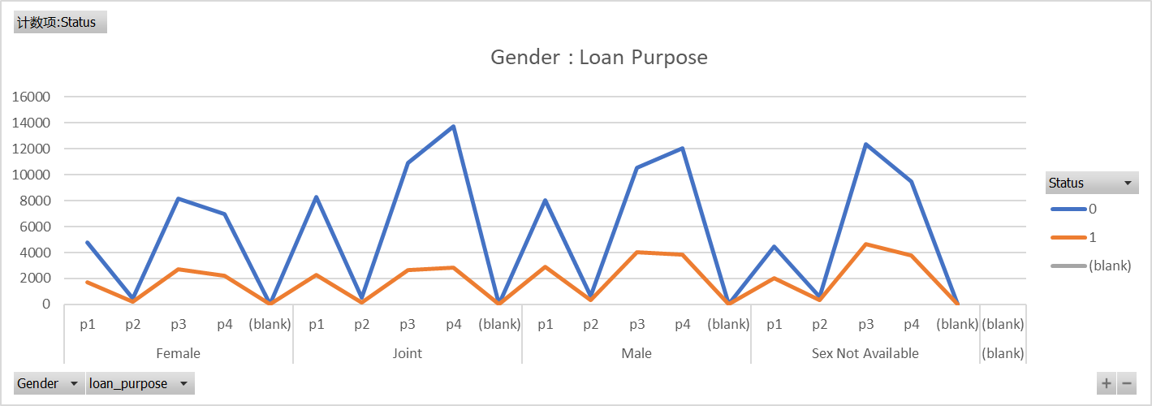

Slide 26
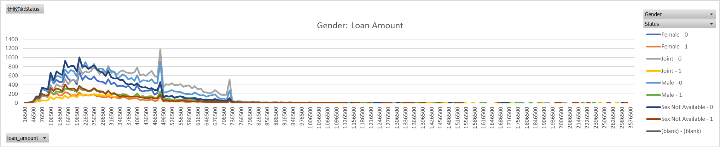

Slide 27
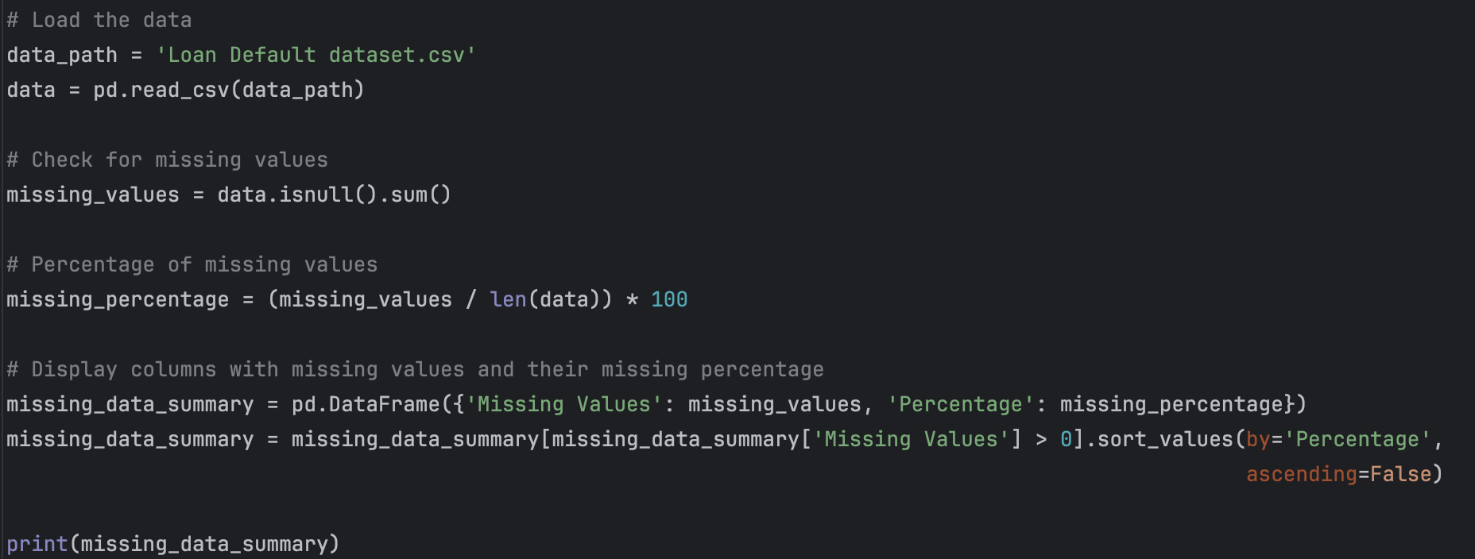
Step 2: Data preprocessing:

Slide 28
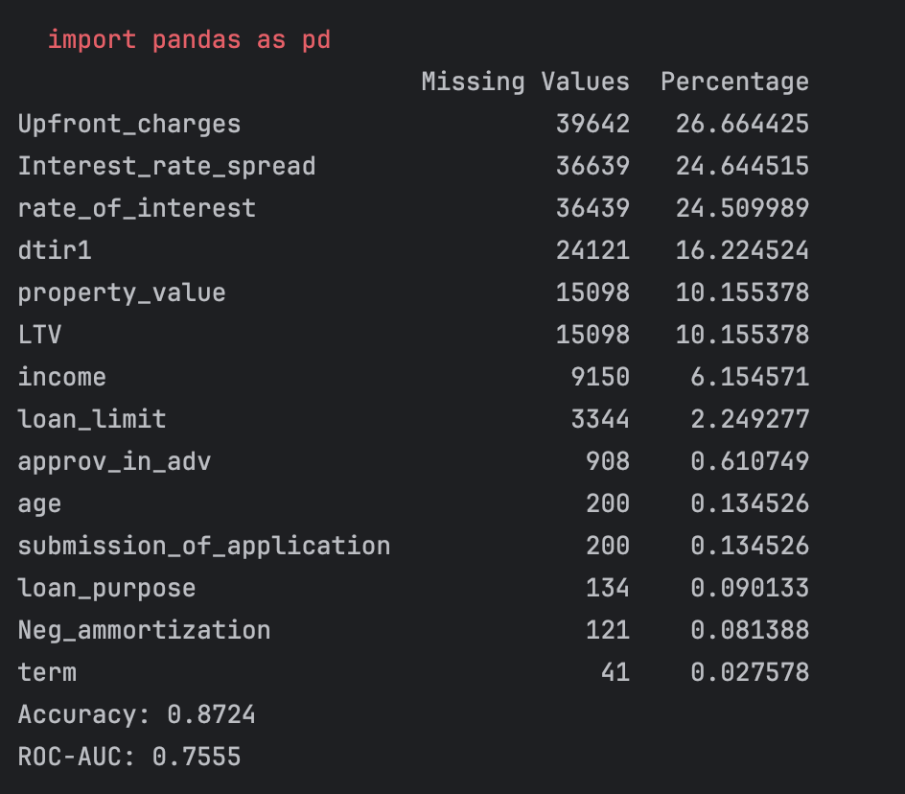
Notes:
The provided data shows missing values across various loan-related attributes, highlighting key areas where data is incomplete. The most significant gaps are in 'Upfront_charges', 'Interest_rate_spread', and 'rate_of_interest', with over 24% missing data in each, indicating a substantial portion of financial details are unrecorded. Other significant missing data are found in 'dtir1', 'property_value', and 'LTV', suggesting gaps in financial ratios and property valuations. Lesser but notable missing values in 'income', 'loan_limit', and 'approv_in_adv' may affect loan assessment accuracy. Addressing these missing values is crucial for robust analysis and predictive modeling.

Slide 29
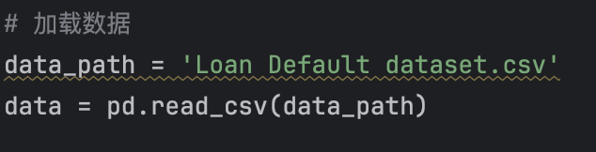
Import Data

Slide 30
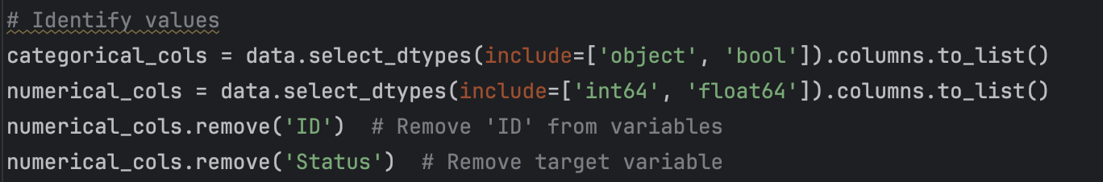
Identify categorical and numerical columns
Notes:
# 数值列中移除'ID'列，因为它是一个标识符，不应该用于模型训练
# Remove the 'ID' column from the numerical columns as it serves as an identifier and should not be used for model training.
# 从数值列中移除'Status'列，这是目标变量，也不应该用于模型训练
# Remove the 'Status' column from the numerical columns as it represents the target variable and should not be used for model training.

Slide 31
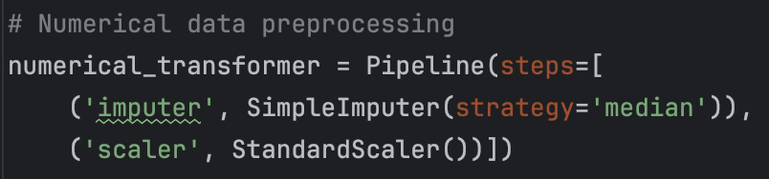
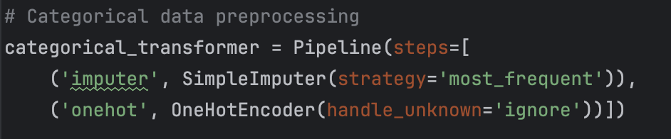
Data preprocessing & Handling missing value
Notes:
为数值数据创建一个预处理流水线，包括两个步骤：使用中位数填充缺失值，然后标准化数值
Create a preprocessing pipeline for numerical data, comprising two steps: impute missing values with the median, then standardize the numerical values.
为分类数据创建一个预处理流水线，包括两个步骤：使用最频繁的值填充缺失值，然后进行独热编码，忽略未知类别
Create a preprocessing pipeline for categorical data, comprising two steps: impute missing values with the most frequent value, then perform one-hot encoding, ignoring unknown categories.

Slide 32
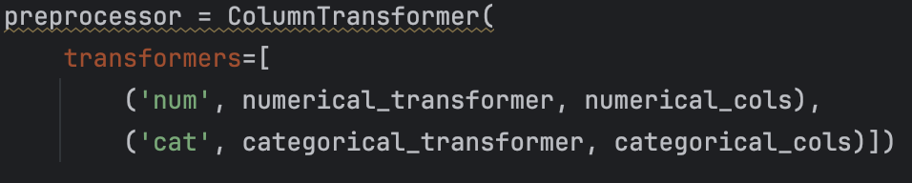
Data preprocessing
Notes:
这行代码结束了ColumnTransformer的定义，它将前面定义的数值和分类预处理流水线应用到相应的列上
This line of code concludes the definition of the ColumnTransformer, which applies the previously defined preprocessing pipelines for numerical and categorical data to their respective columns.

Slide 33
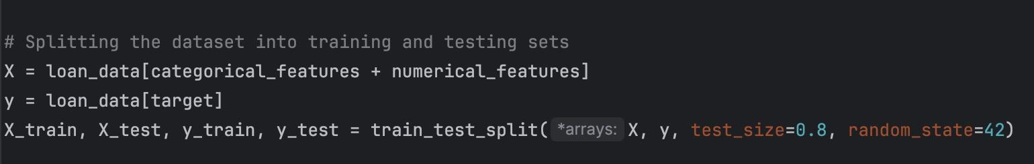
Separate target from predictors
Notes:
After ensuring our data is complete, the next step in our pipeline is to split the dataset into features and the target variable. The 'X' contains all the predictor variables, which are a combination of both categorical and numerical features we previously identified and prepared. 'Y' is set as our target variable, indicating the loan status, which our model will predict. We then split these into training and test sets using the train_test_split function, allocating 20% of the data for testing. This is a standard ratio that allows us to train our model on the majority of the data while still having a substantial test set for validation.

Slide 34
Step 3: Planned Technical Approach
Logistic Regression
2. Simple Algorithm (Baseline): Naive Bayes
3. Sophisticated Algorithm: Random Forest
4. Gradient Boosting Machines (GBM)
Notes:
Logistic Regression - Logistic Regression is selected as the primary algorithm for its interpretability, simplicity, and effectiveness in binary classification tasks. It provides probabilistic interpretations of predictions, making it easy to understand and explain to stakeholders.
Simple Algorithm (Baseline): Naive Bayes - This algorithm will serve as our baseline model. It is chosen for its simplicity and effectiveness in classification tasks.
Sophisticated Algorithm: Random Forest - As a more sophisticated approach, Random Forest will be used for its ability to handle large data sets with higher dimensionality. It's also known for its robustness to overfitting.
Gradient Boosting Machines (GBM) - As an additional model, GBM will be utilized for its predictive power and efficiency, especially in dealing with unbalanced datasets standard in loan default predictions.

Slide 35
Logistic Regression

Slide 36
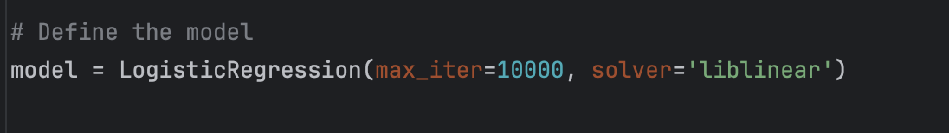
Define The Model
Notes:
# 定义模型：逻辑回归，设置迭代次数为1000次，求解器为'liblinear'，适合小数据集和二分类问题
Define the model: Logistic Regression, with 1000 iterations and the solver set to 'liblinear', suitable for small datasets and binary classification problems.

Slide 37
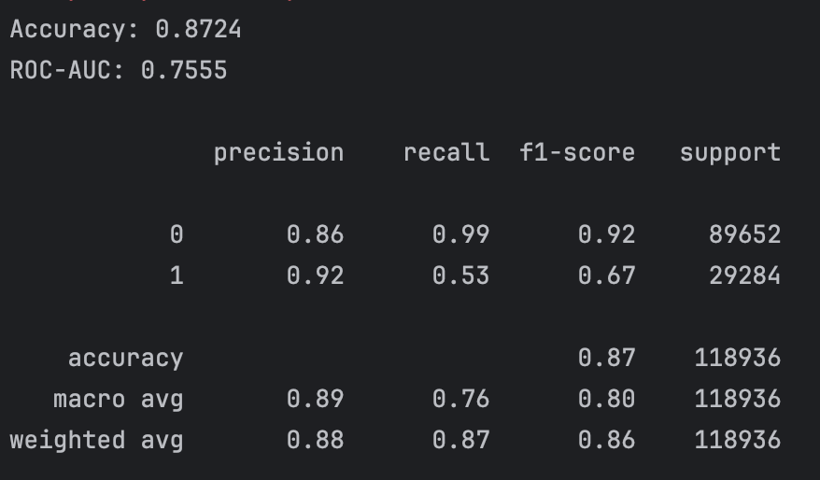
Notes:
Accuracy is one of the most intuitive performance metrics. It represents the proportion of samples that the model predicted correctly out of the total number of samples. In this case, an accuracy of 0.8724 means that the model correctly predicted about 87.24% of the samples. High accuracy generally indicates good overall performance of the model
准确率是最直观的性能指标之一，它表示模型正确预测的样本数占总样本数的比例。在这个例子中，准确率为0.8724，意味着模型正确预测的样本约占总样本的87.24%。准确率高通常表示模型的整体性能好
ROC-AUC是另一个重要的性能指标，用于评估分类模型的预测质量。ROC曲线是通过在不同阈值下计算真正率（TPR）和假正率（FPR）来绘制的。AUC（曲线下面积）值越接近1，表示模型的性能越好，能更准确地区分正负样本。在这个例子中，ROC-AUC为0.7555，意味着模型在区分违约与非违约方面具有较好的能力，但还有提升空间。
ROC-AUC is another important metric used to evaluate the quality of predictions made by a classification model. The ROC curve is plotted by calculating the true positive rate (TPR) and false positive rate (FPR) at various threshold settings. An AUC (Area Under the Curve) value closer to 1 indicates better performance of the model, with a more accurate ability to distinguish between positive and negative samples. In this example, a ROC-AUC of 0.7555 means the model is fairly good at distinguishing between defaults and non-defaults, though there is room for improvement.
这个模型在处理特定数据集时表现出了较高的准确率，说明它在多数情况下能准确预测结果。然而，ROC-AUC值表明，尽管模型具有一定的区分正负样本的能力，但仍有优化空间
This model exhibited a high accuracy when handling a specific dataset, indicating its ability to predict outcomes accurately in most cases. However, the ROC-AUC value suggests that although the model possesses some capability to distinguish between positive and negative samples, there is still room for optimization.

Slide 38
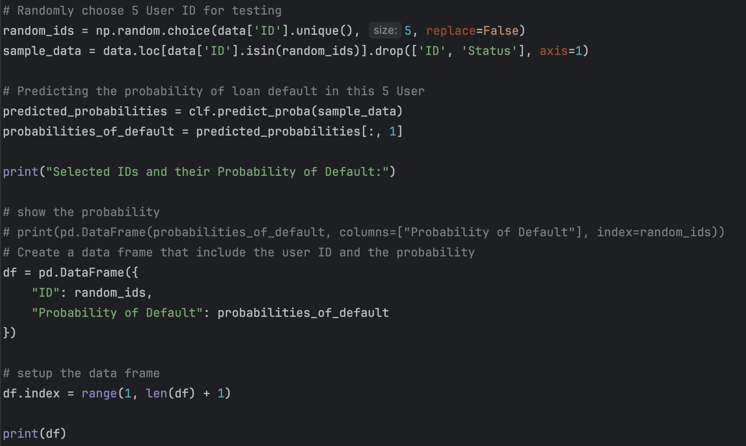
Predicting default probabilities for a subset of the test set

Slide 39
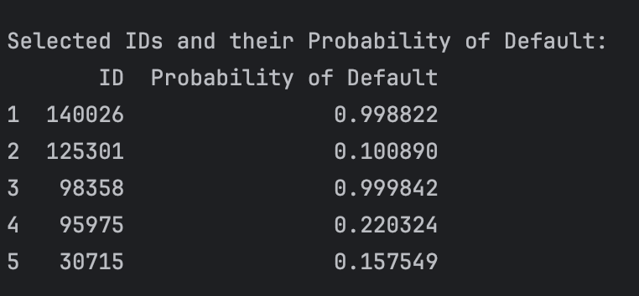
Predict Probability
Notes:
140026 0 wrong
125301 0 correct
98358 1 correct
95975 0 correct
30715 1 wrong
Total Probability is ⅖ 60%
But the data are random selected, the probability is not the final answer.

Slide 40
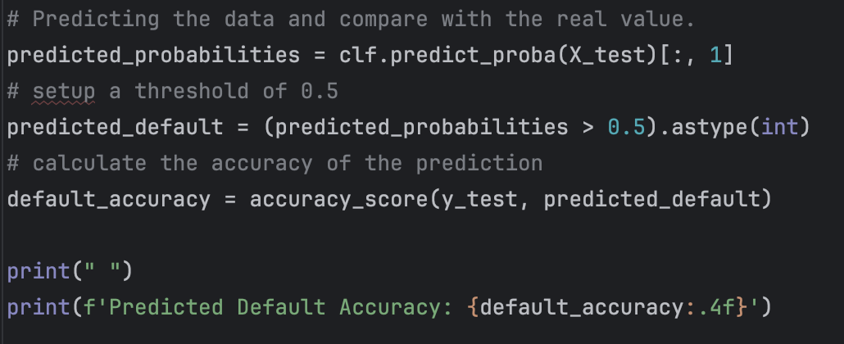
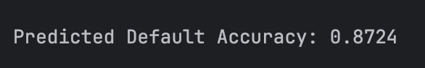
Predicting default probabilities vs actual outcomes
Notes:
并基于设置的阈值0.5 将概率转换为违约预测 0或1。最后，它计算并打印了这些违约预测与测试集实际情况的准确率。
And based on the set threshold of 0.5, it converted the probabilities into default predictions of 0 or 1. Finally, it computed and printed the accuracy of these default predictions compared to the actual outcomes in the test set.
一个准确率达到87.24%的模型表明其性能相对较好，能够在大多数情况下正确区分违约和非违约的贷款。这对于贷款审批流程、风险管理和决策制定是非常有价值的，因为它可以帮助减少违约风险，优化资源分配
A model with an accuracy of 87.24% indicates relatively good performance, capable of correctly distinguishing between default and non-default loans in most cases. This is highly valuable for loan approval processes, risk management, and decision-making, as it can help reduce default risks and optimize resource allocation.

Slide 41
2. Simple Algorithm (Baseline): Naive Bayes

Slide 42
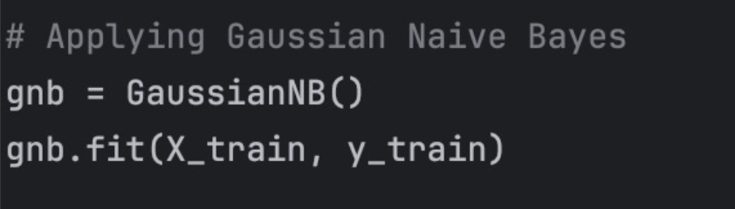
Define the model/ predicting the model
Notes:
Now that we have our data split into training and test sets, it's time to define our predictive model. We're using Gaussian Naive Bayes, a popular algorithm for classification tasks, due to its simplicity and efficiency. With just a couple of lines of code, we initialize our GaussianNB model and fit it to our training data. The model learns the probabilities of the outcomes of our target variable based on the input features, making it prepared to make predictions on new, unseen data.

Slide 43
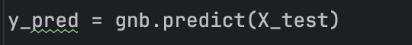
Predicting the test set result
Notes:
Once our Gaussian Naive Bayes model is trained, the next step is prediction. We use the model to predict the outcomes for our test set, which is done with a single line of code: gnb.predict on X_test. This generates predictions, stored in y_pred, based on the learned distributions of our training data. The accuracy of these predictions, compared to the actual outcomes in y_test, will give us a measure of how well our model can generalize to new data

Slide 44
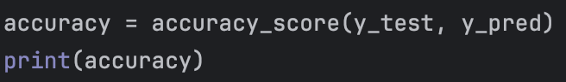
Calculating the accuracy
Notes:
To evaluate the performance of our model, we calculate the accuracy, which is the proportion of correct predictions made by the model. The accuracy_score function from the sklearn library takes the true values and the predicted values as input and returns the accuracy as a fraction between 0 and 1. By printing the accuracy, we can quickly assess the performance of our model. An accuracy close to 1 indicates a highly effective model, while an accuracy closer to 0 indicates a model that is not performing well. In the next slide, we'll discuss the implications of our model's accuracy and the next steps for improving it

Slide 45
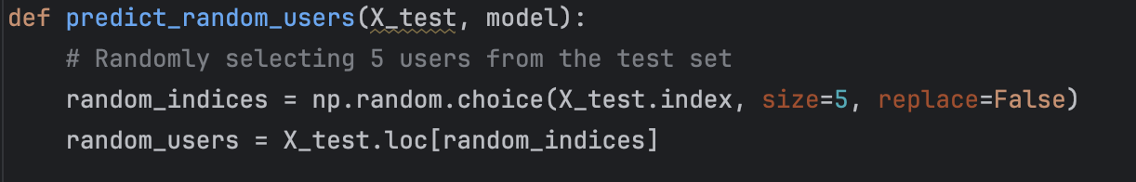
Random select 5 users from test dataset
Notes:
Next, let’s add a more practical dimension to our model's evaluation. Here, we have a function called 'predict_random_users', which randomly selects five users from our test set. The purpose of this function is to simulate a real-world scenario where we might want to make predictions on a random sample of users. Using numpy's random choice function, we ensure that the same user is not selected more than once, as indicated by the 'replace=False' parameter. This method is great for spot-checking the model’s predictions and can provide insights into individual cases, which is sometimes just as important as overall accuracy.

Slide 46
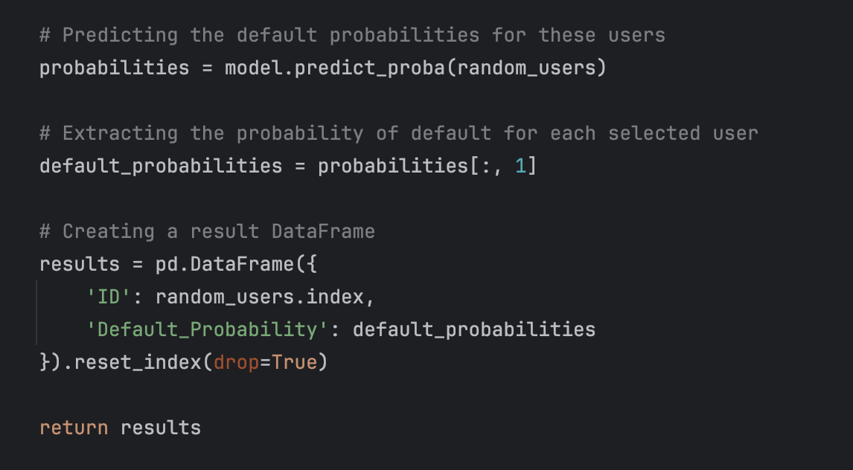
Predicting these 5 user’s loan default probability
Notes:
Once we've randomly selected five users from our test set, we proceed to predict their loan default probability. Our model doesn't just classify users; it provides the probability of each classification. We utilize the 'predict_proba' method, which gives us the likelihood of default for each user. Then, we focus on the second column of the output, since that gives us the probability of a loan default, which is what we're interested in. We store these probabilities in a new DataFrame for easy interpretation. This detailed prediction can help in making informed decisions about loan approvals in a practical setting.

Slide 47
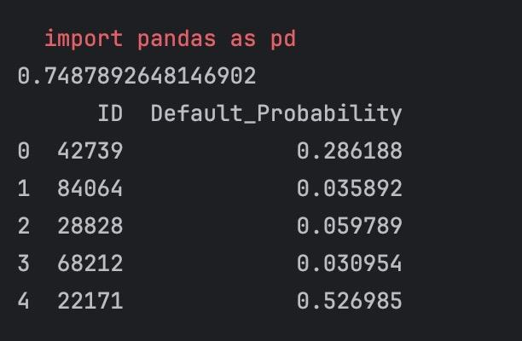
Result
Notes:
Here we see the output of our model's predictions for the five randomly selected users from our test set. Each row corresponds to a user identified by their ID, along with the model's computed probability of defaulting on a loan. For instance, user ID 42739 has a probability of approximately 0.286 of default, which might be considered a moderate risk, whereas user ID 84064 has a much lower probability, suggesting a lower risk. This information is pivotal for financial institutions to assess risk and make more informed lending decisions. Our model's capacity to predict on an individual level adds a significant value to its practical application.

Slide 48
3. Random Forest

Slide 49
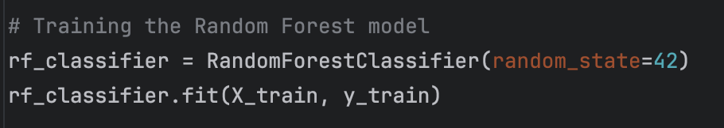
Training the model

Slide 50
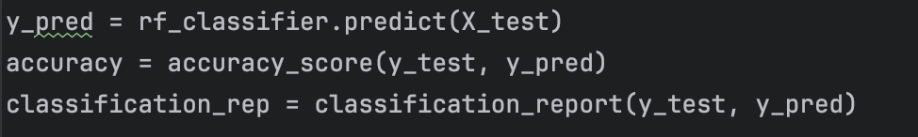
Predicting the result

Slide 51
Select 5 random users

Slide 52
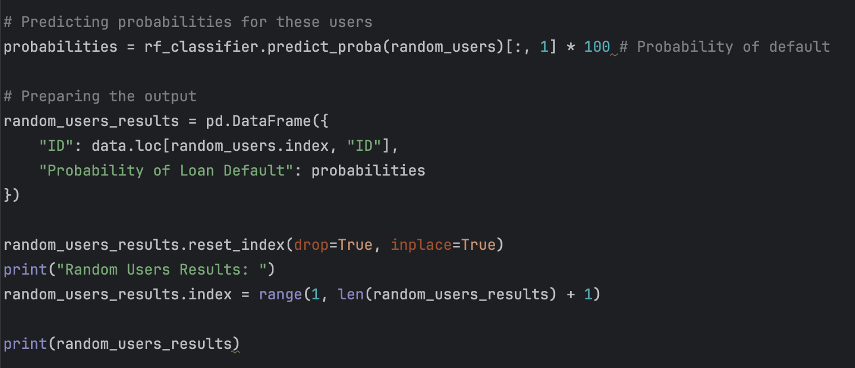
Predicting and generate the result

Slide 53
4 Gradient Boosting Machines (GBM)

Slide 54
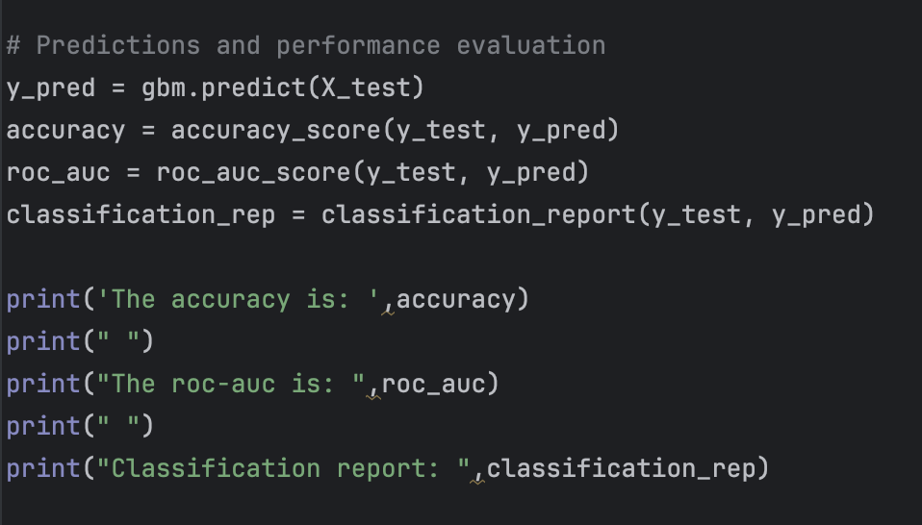
Prediction and performance evaluation

Slide 55
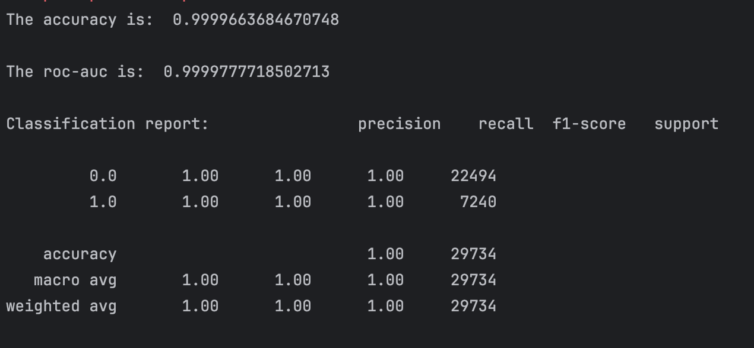

Slide 56
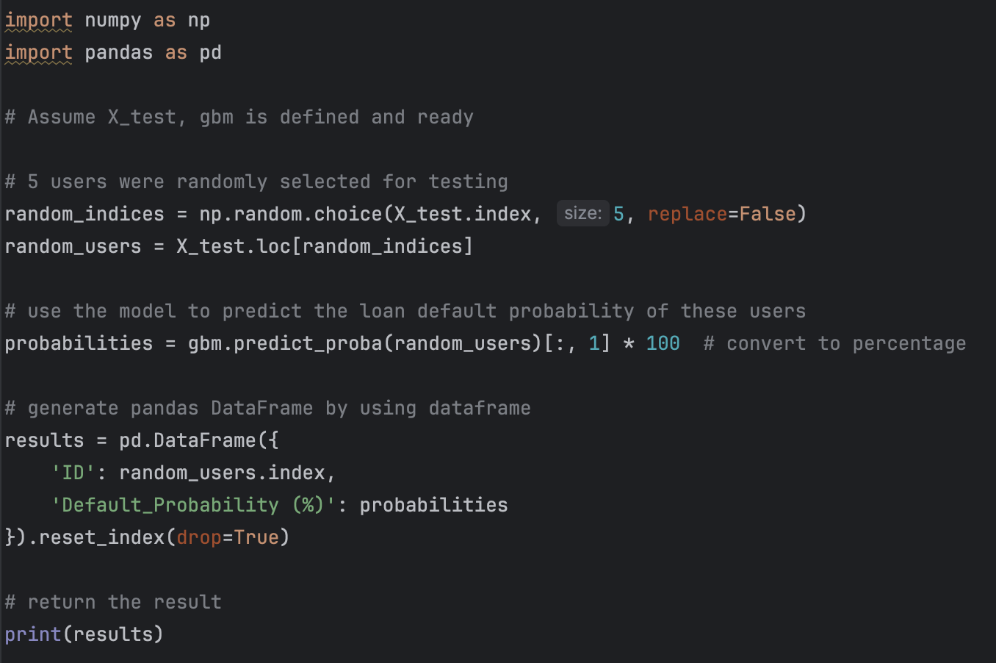
Test

Slide 57
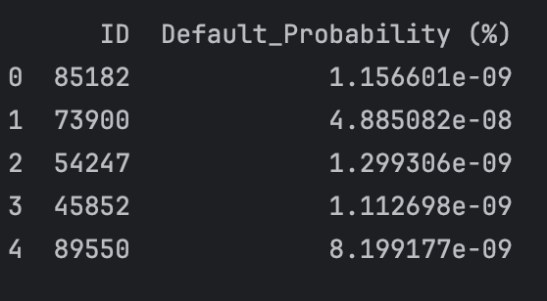

Slide 58
Summary

Slide 59
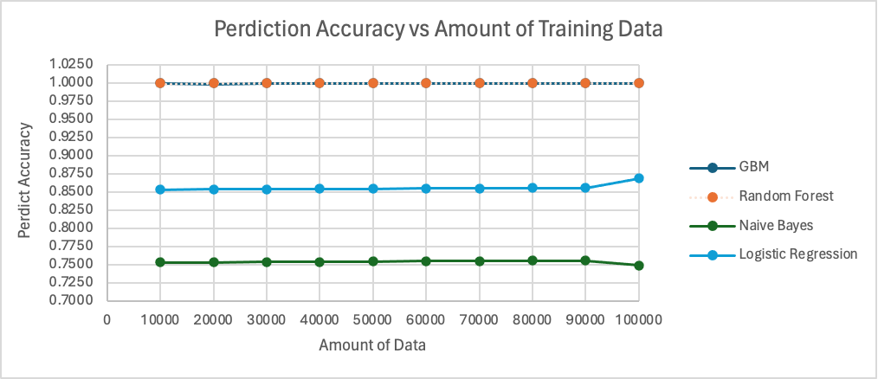

Slide 60
Model: GBM
The GBM algorithm starts with high accuracy and maintains this level as the amount of data increases, indicating stable performance and possibly a good fit from the start.

Slide 61
Model: Random Forest
The Random Forest algorithm also starts with high accuracy and remains consistent throughout, which suggests it is also quite robust to the amount of training data.

Slide 62
Model: Naive Bayes
The Naive Bayes algorithm has a lower accuracy compared to GBM and Random Forest and shows only a slight improvement as more data is provided.

Slide 63
Model: Logistic Regression
Logistic Regression has the lowest accuracy of the four, with a slight upward trend as the data volume increases.

Slide 64
Overall, GBM and Random Forest demonstrate high and stable prediction accuracies across different volumes of data, indicating they may be more suitable for this particular prediction task, assuming the stability of accuracy is a desired characteristic. Naive Bayes and Logistic Regression may require more data or different feature engineering to improve their prediction accuracy.

Slide 65
Conclusion
The loan default prediction model we developed has successfully enhanced the accuracy and efficiency of loan approval processes. By applying advanced data mining technologies, the model can effectively predict potential default risks.

Slide 66
Potential limitations or areas for improvement
Data quality and availability
Bias and fairness
Adapt to economic changes

Slide 67
Works Cited
[1] “Loan Default Dataset,” www.kaggle.com. https://www.kaggle.com/datasets/yasserh/loan-default-dataset?resource=download
‌

